Slide 1

Iteration 3:: “The Marketeers”
Team Leader: Raquel Trejo
Memebers: Ahla Cho, Michael Ellerkamp

Slide 2
Functional Requirements
R1. The System, hereby called Market, may create a database of World of Warcraft items.
R2. The Items may contain buy price, sell price, number sold & item ID.
R3. The User may easily search for items that cost less to buy than to sell.
R4. The User may select what server the User wishes to browse item data from.
R5. The User may Load and Run pre-made algorithms from the website.
R6. The User may input and run personal algorithms
R7. The User may see the top 10 items with the most increase in sell value, most decrease in sell value, most sold items on the server.
R8. The User may search for items and see a short history of the item’s price.
R9. The User may consult a help guide for quick answers.

Slide 3
Nonfunctional Requirements
R1. Online apps
R2. Limited amount of server space
R3. Query response time
R4. Semi hourly database updates
R5. Method limits API

Slide 4
Use Case Diagram
Market
Search
Market
Load
Start up
Change Server
Shutdown
Help
User
Admin
Top 10 least sold
Top 10 increase
Top 10 Decrease
Top 10 Most sold

Slide 5
Expanded Use Case: Top 10 increase in price
Precondition: User is at Home Section
Actor: User | System: Market
 | (0)Market displays homescreen GUI
(1)TUCBW User clicks top 10 highest gain | (2) Market calling the top 10 increased controller to search and display up to 10 items that have the highest increase in price since last hour.
(3) TUCEW User see list

Slide 6
Sequence Diagram: Get TOP 10 items increase in price

Slide 7
Expanded Use Case: Top 10 decrease in price
Precondition: User is at Home Section
Actor: User | System: Market
 | (0)Market displays homescreen GUI
(1)TUCBW User clicks top 10 decrease. | (2) Market calling the top 10 decrease controller to search and display up to 10 items that have the highest decrease in price since last hour.
(3) TUCEW User see list

Slide 8
Sequence Diagram: Get TOP 10 items decrease in price

Slide 9
Expanded Use Case: Top 10 Least Sold
Precondition: User is at Home Section
Actor: User | System: Market
 | (0)Market displays homescreen GUI
(1)TUCBW User clicks top 10 least sold | (2) Market calling the top 10 least sold controller to search and display up to 10 items that have the least amount of sold since last hour.
(3) TUCEW User see list

Slide 10
Sequence Diagram: Get TOP 10 items least sold

Slide 11
Expanded Use Case: Top 10 most sold
Precondition: User is at Home Section
Actor: User | System: Market
 | (0)Market displays homescreen GUI
(1)TUCBW User clicks top 10 most sold. | (2) Market calling the top 10 most sold controller to search and display up to 10 items that are sold the most the past hour.
(3) TUCEW User see list

Slide 12
Sequence Diagram: Get TOP 10 items most sold

Slide 13
Expanded Use Case: Search
Precondition: User is at Search Section
Actor: User | System: Market
 | (0)Market displays Search GUI
(1)TUCBW User enters an item’s full or partial name into Search Bar then click Search. | (2) Market calling the search controller to search for items with full or partial match and lists them.
(3) Selects the item they wish to view. | (4) Market displays data about selected item.
(5) TUCEW User reads data.

Slide 14
Sequence Diagram: Search

Slide 15
Expanded Use Case: Change Server
Precondition: User is at any section.
Actor: User | System: Market
 | (0)Market displays section GUI
(1)TUCBW User clicks change server icon | (2) Market calling the server controller displays server list.
(3) User selects desired server. | (4) Market load data from that server.
(5) TUCEW User returns to original section with new server data.

Slide 16
Sequence Diagram: Change Server

Slide 17
Expanded Use Case: Load
Precondition: User is at algorithm section.
Actor: User | System: Market
 | (0)Market displays algorithm GUI
(1)TUCBW User enters name of item to be searched for. | (2) Market finds a list of items with full or partial matching names.
(3) User selects desired item | (4) Market displays data about item
(5) User selects pre-set algorithm to apply to item | (6) Market applies algorithm to item’s sell history.
(7) TUCEW User interprets data.

Slide 18
Expanded Use Case: Test
Precondition: User is at Test section.
Actor: User | System: Market
 | (0)Market displays test GUI
(1)TUCBW User enters name of item to be searched for. | (2) Market finds a list of items with full or partial matching names.
(3) User selects desired item | (4) Market displays data about item
(5) User enters custom algorithm to apply to item | (6) Market applies algorithm to item’s sell history.
(7) TUCEW User interprets data.

Slide 19
Sequence Diagram: Algorithm(load/test)

Slide 20
Expanded Use Case: Start up
Precondition
Actor: Admin | System: Market
(1) TUCBW Admin starts mysql | (2) Server boots up
(3) TUCEW Admin interacts with program

Slide 21
Sequence Diagram: start up

Slide 22
Expanded Use Case: Shut down
Precondition:
Actor: Admin | System: Market
(1) TUCBW Admin stops mysql | (2) Server shuts down
(3) TUCEW Admin registers server shutdown

Slide 23
Sequence Diagram: Shut Down

Slide 24
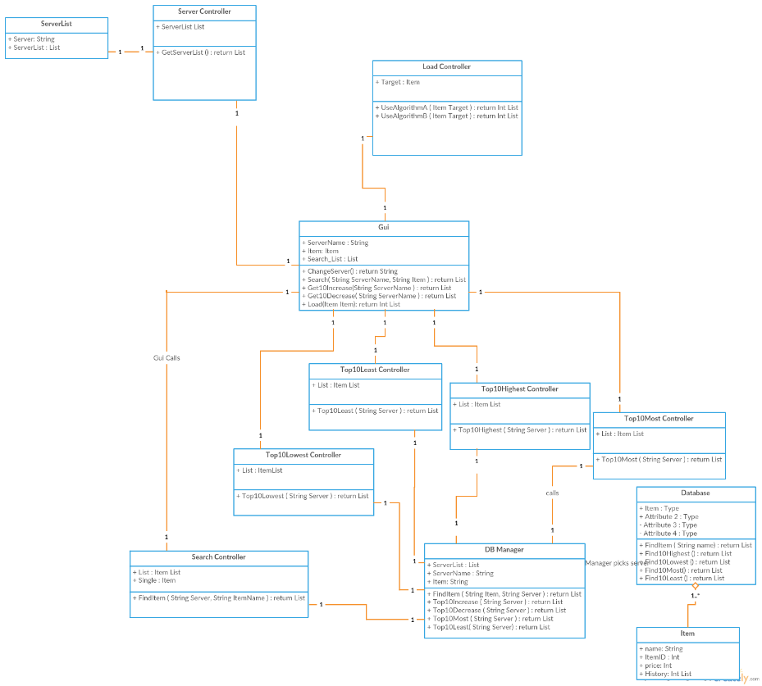
Domain Model

Slide 25
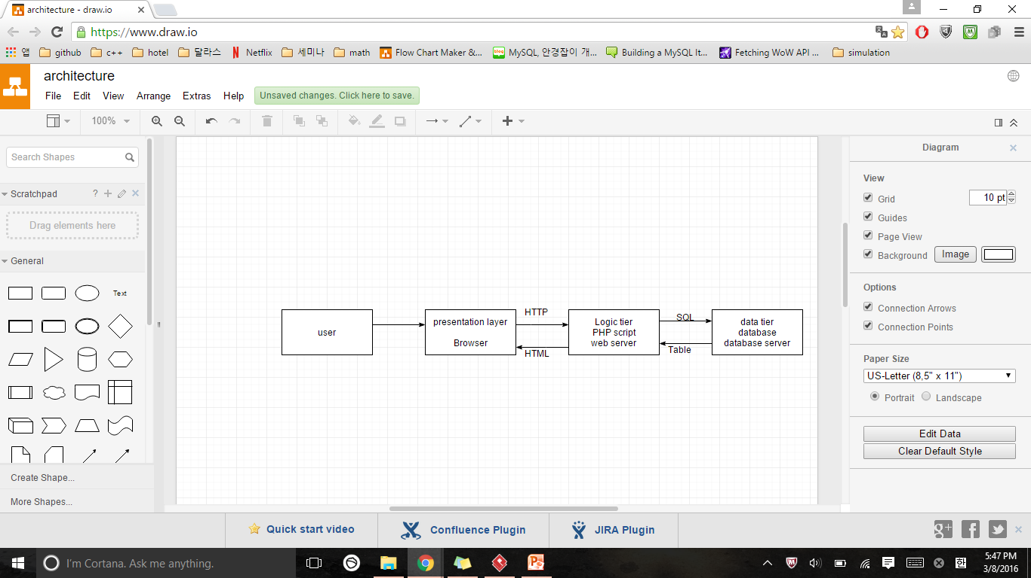
Architectural Model 3-tier Architecture
Presentation tier (GUI)
The top-most level of the application is the graphical user interface.
To translate tasks and results to something the user can understand
Logic tier (system)
Coordinate the application, processes commands, makes logical decisions and evaluations, and performs calculations.
Data tier
Information is stored and retrieved from a database. The information is then passed back to the logic tier for processing and then eventually back to user (WOW server)

Slide 26

Schedule Update
Implement algorithms
More advanced testing techniques
Add graphs and item images
Make GUI more presentable
Update item list to latest WoW version

Slide 27
Team member work accomplished
Raquel: GUI (Java), MySQL Database, PHP Scripts, Crontab, project demo, results
Michael: UML class diagrams, testing, assisted with API information
Ahla: Sequential diagrams, architectural model, PowerPoint slides

Slide 28
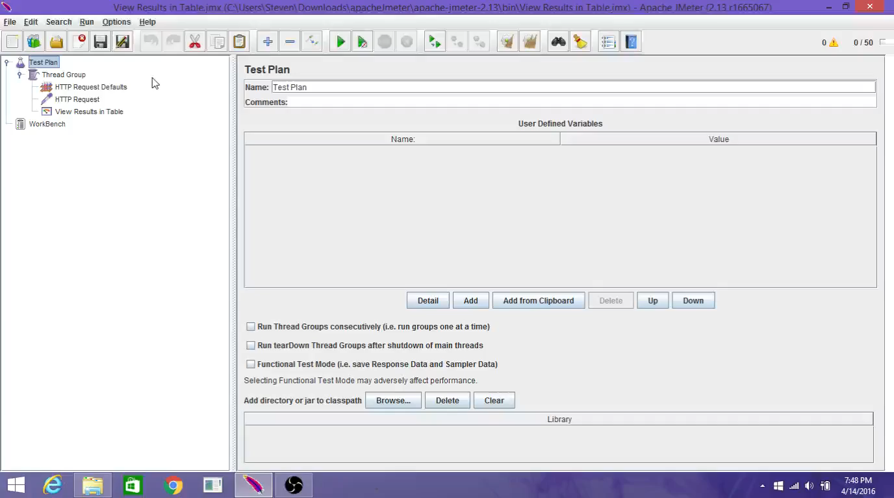
Testing- Apache Jmeter

Slide 29
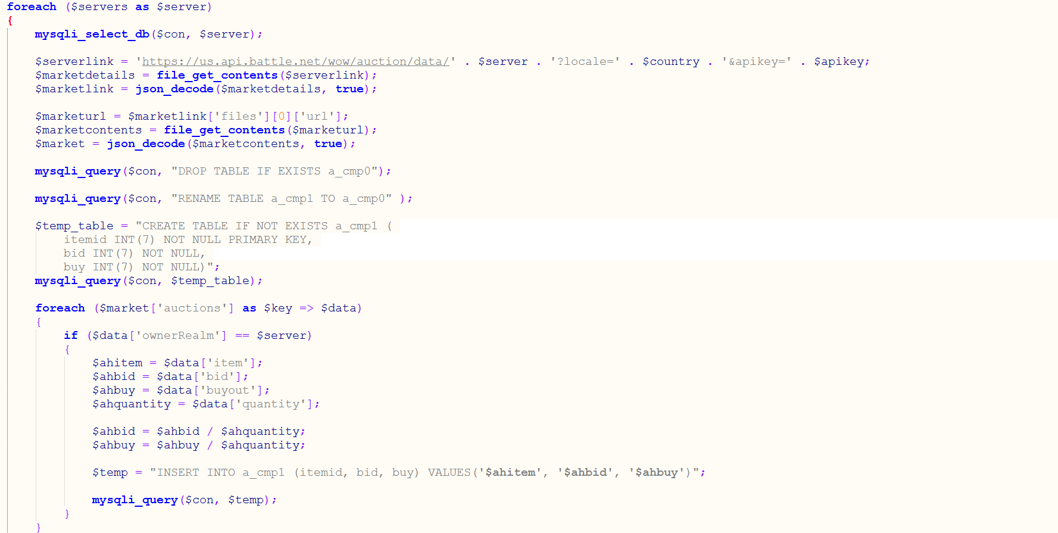
PHP Script

Slide 30
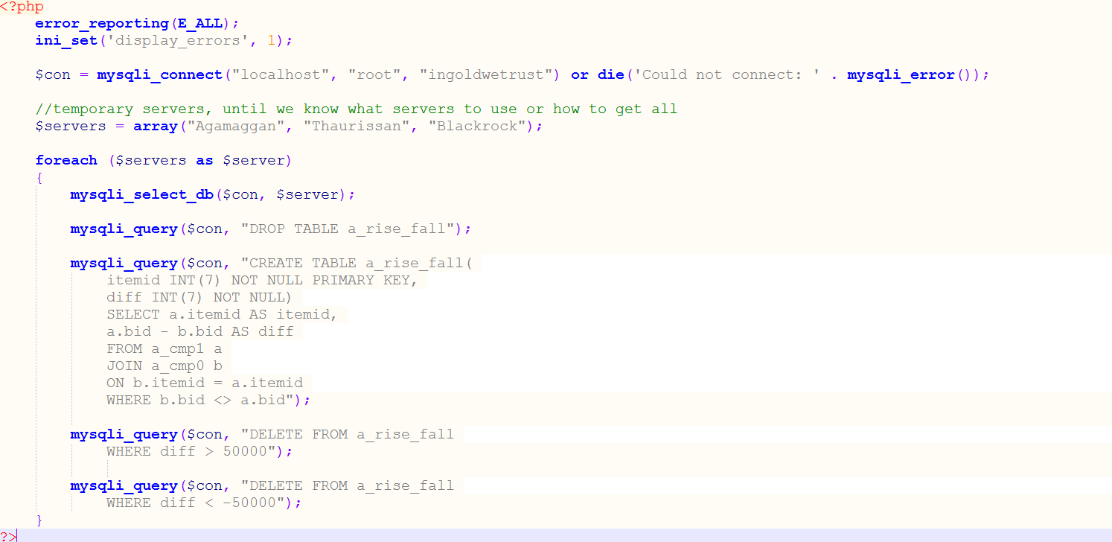
More PHP Scripts

Slide 31
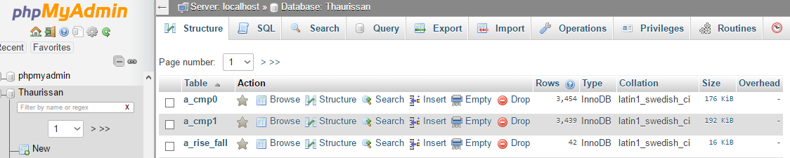
Tables created

Slide 32
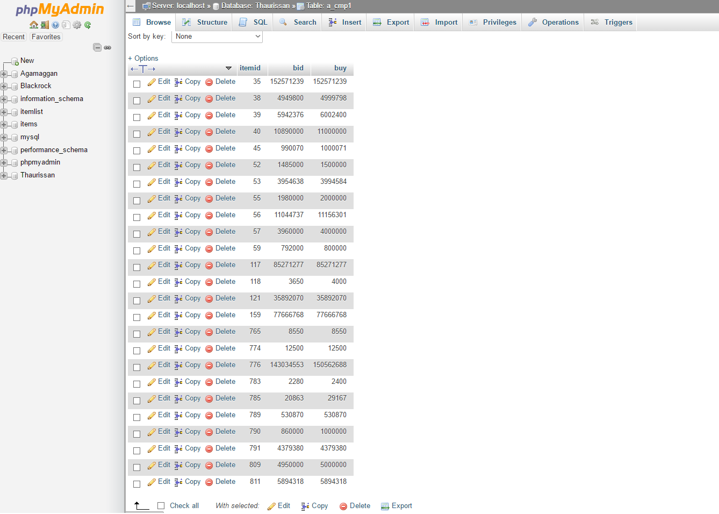
Table: a_cmp0 / a_cmp1

Slide 33
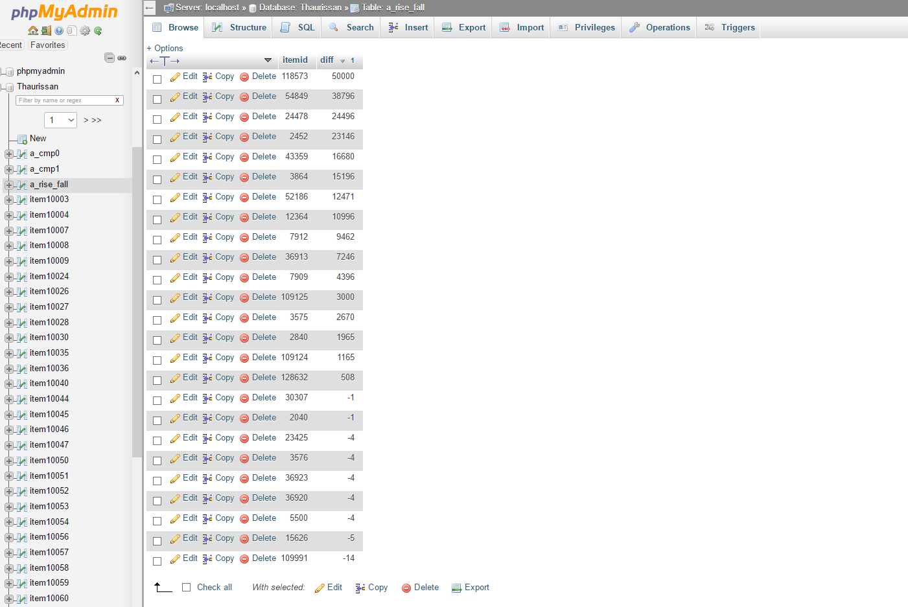
Table: a_rise_fall

Slide 34
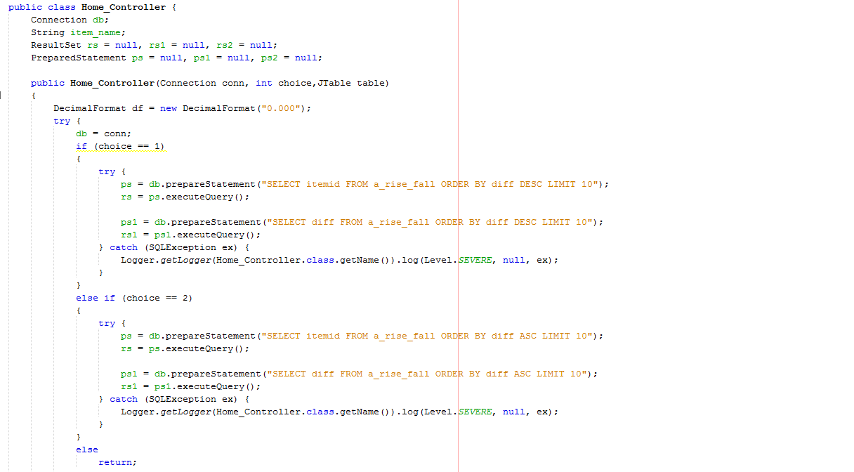
Home_Controller

Slide 35
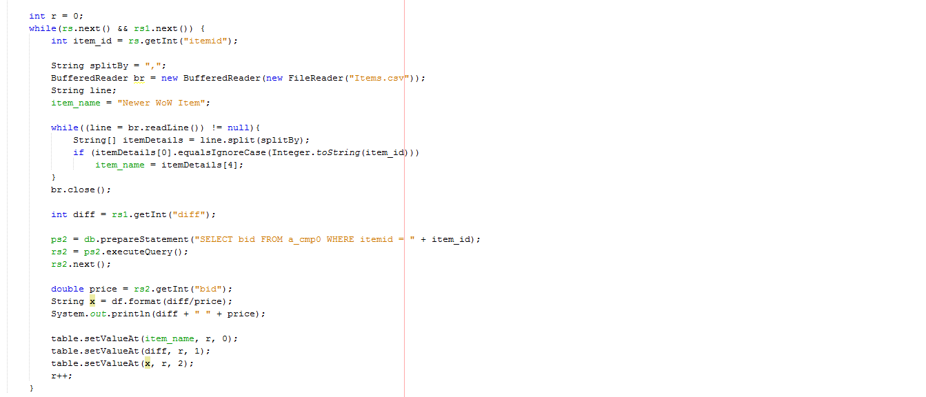
Home_Controller cont.

Slide 36
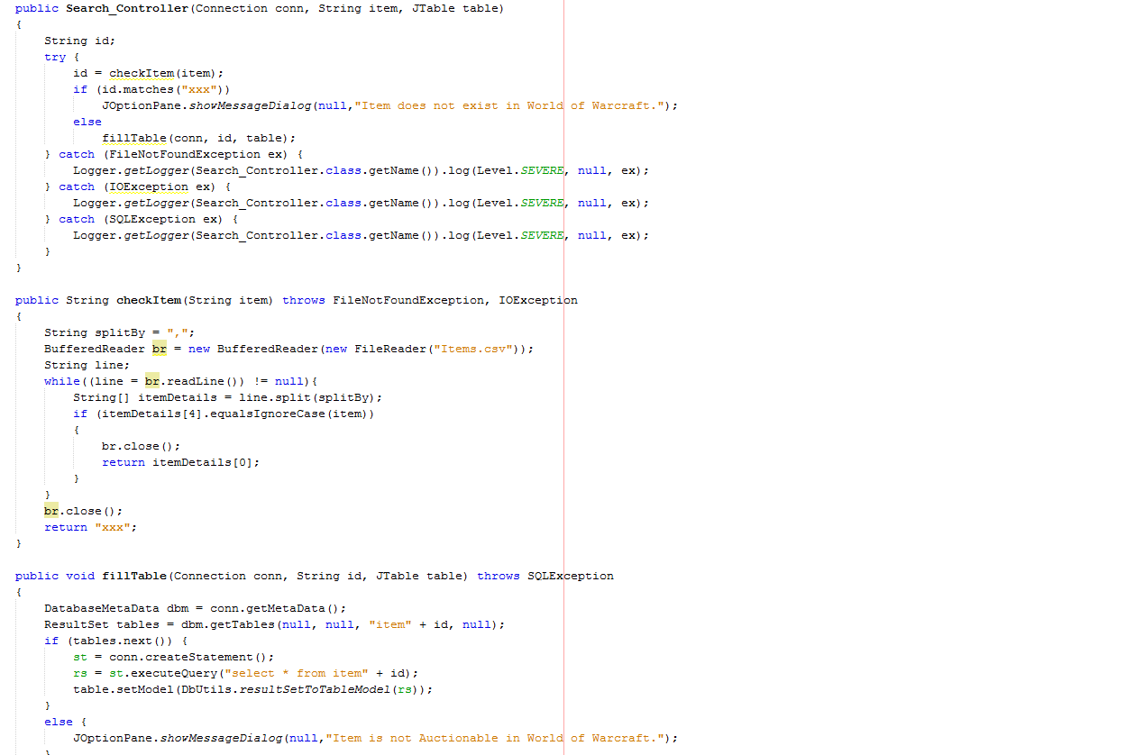
Search_Controller

Slide 37
Search_Controller

Slide 38
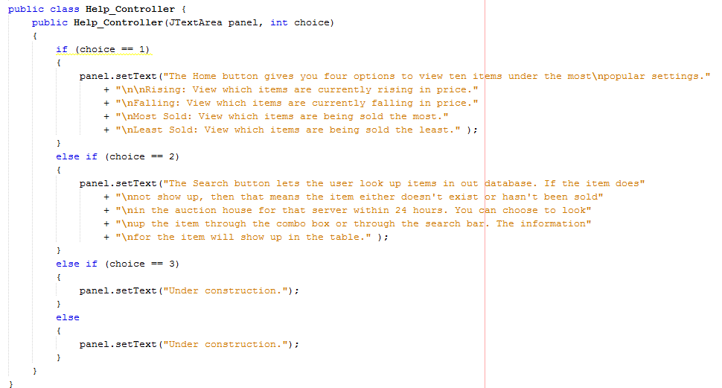
Help_Controller

Slide 39
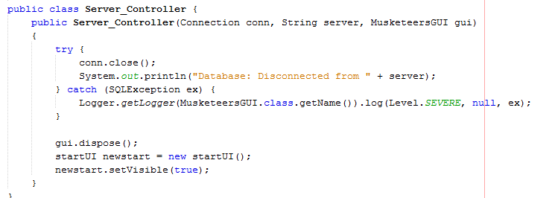
Server_Controller

Slide 40
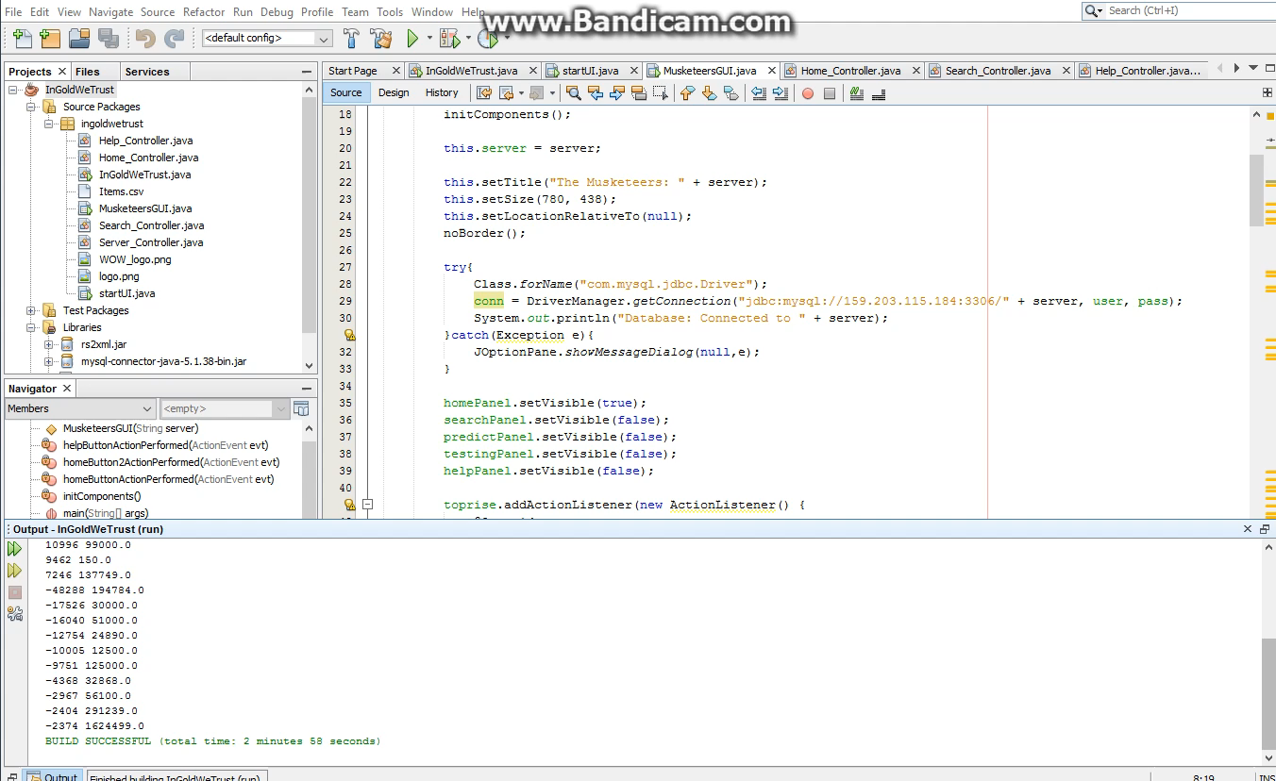
GUI

